Slide 1

The Final Push
Python Pandas/Jupyter
HTML/CSS/BootStrap
JavaScript Leaflet

Slide 2

Machine Learning Final Project
By:
Kevin Athey
Benjamin Raehpour
Ricardo Dominguez
Aaron Schwartzman
Grecia Acosta

Slide 3
All about Linguistics
Overview or Background:
Kevin Athey has a background in linguistics with a specialization in linguistic typology.
An enormous dataset is available at wals.info of typological information categorizing 2,662 languages by 192 different featural categories.
As can be seen from the wals.info site, languages tend to group geographically by typological features. Such areal phenomena may potentially be usable to predict languages from their features alone.

Slide 4

Hypothesis: Is it possible to predict the likely location of a language from its characteristics?
Notes:
Consider talking about:
Machine learning tasks

Slide 5

The process
Notes:
Consider talking about:
Types of learning algorithms
Models
Training models

Slide 6

Data Data Data!
The World Atlas of Language Structures (WALS) is a large database of structural (phonological, grammatical, lexical) properties of languages gathered from descriptive materials (such as reference grammars) by a team of 55 authors who are experts in these languages.
https://wals.info/feature

Slide 7
Data Cleaning Scrapping (Tap Separated Dataset)
Load Dataset
• We used pandas to load the data. We also used pandas to explore the data visualization.
Data exploration
• What surprises each dataset holds? (192 Datasets Total )
Data cleansing
• Eliminate errors that muddy the waters . Removed all the columns that didn't need for our prediction.
Data blending
• Join multiple datasets (The tricky part)
Data profiling
• Convert data to numerical
Summarize the Data
• Make data digestible for our model.

Slide 8
Machine Learning
Machine Learning Process
Create Model
Validate the Model
Testing with Feed Documents
Create Predictions
Evaluate Predictions

Slide 9
Heatmapping
Language Map
Heatmapping was achieved through Leaflet.
It was clear from the heatmapping of the data that prediction may not be possible.
We added markers for languages with features similar to the feed documents.

Slide 10
Let’s Visualize!!
Notes:
Consider talking about:
Relation to data mining
Relation to optimization
Relation to statistics

Slide 11
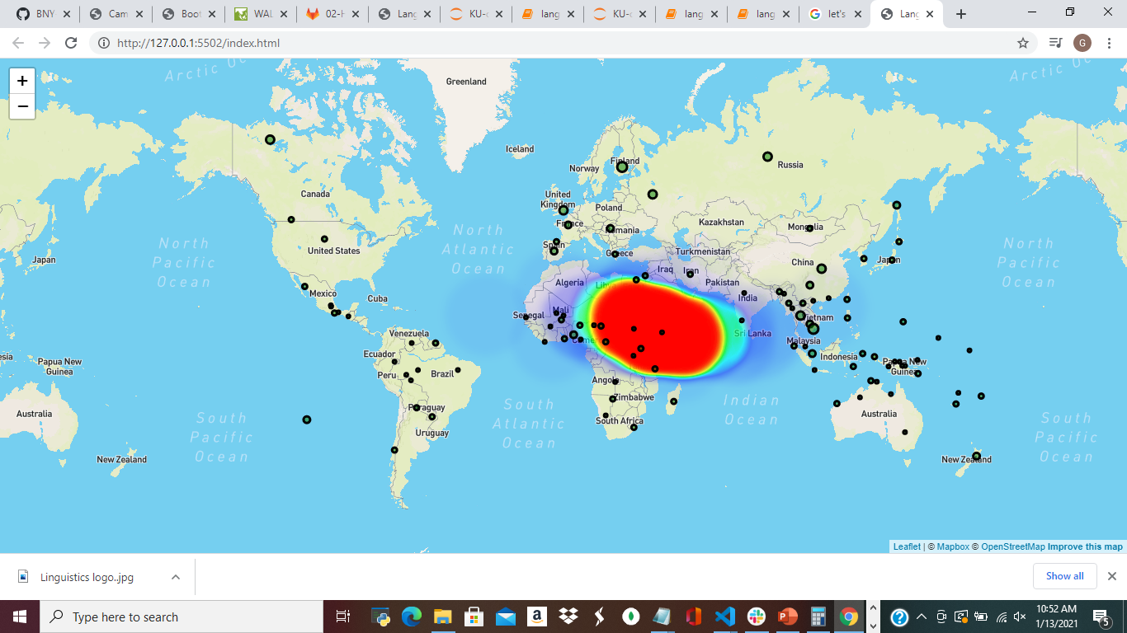
What is the map telling us?

Slide 12
The take-away
Conclusion:
We can’t predict a language’s location based on its characteristics.

Slide 13
Possible Future Functionality
User-friendly interface – replacing the feeder files with a dashboard
More correlational data – which linguistic features correlate with others

Slide 14
Thank you

